Slide 1
Customer Lifetime Value Prediction Model By: Harsh Katariya

Slide 2
Business Objective
Predict each customer’s future value to:
Identify high-value customers
Enable personalized marketing
Optimize customer retention efforts

Slide 3
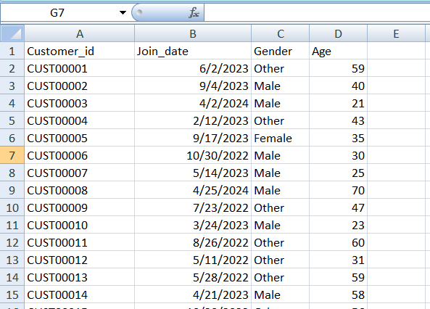
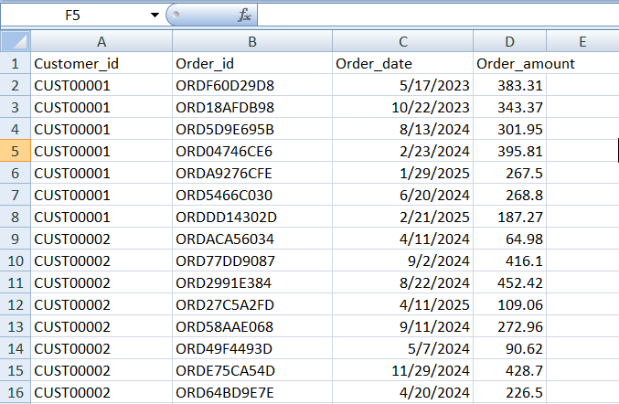
Data Overview
Sources Used:
customers.csv – Customer profiles
transactions.csv – Historical purchases
Time Range: (e.g., Jan 2022 – Dec 2024)
Volume: (e.g., 15,000 customers, 120,000 transactions)

Slide 4
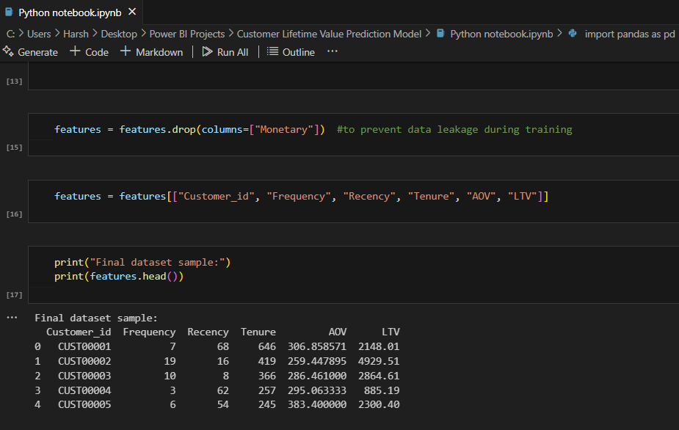
Feature Engineering
Recency – Days since last purchase
Frequency – Total number of orders
Tenure – Days between first and last
purchase
AOV – Average Order Value
All features derived from transaction
history

Slide 5
Modeling Approach
Model Used: XGBoost Regressor
Target Variable: Total historical spend (proxy for LTV)
Training Method: 80/20 split, evaluated with MAE & RMSE
Output:
Model Performance: MAE: 28.27
RMSE: 39.78

Slide 6
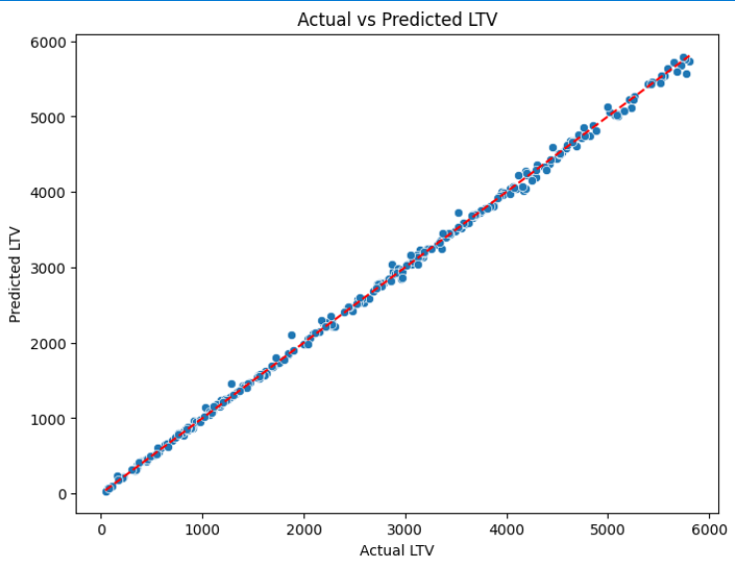
Model Performance
MAE: $32.49
RMSE: $49.66
Acceptable range, some variability due to high-value outliers

Slide 7
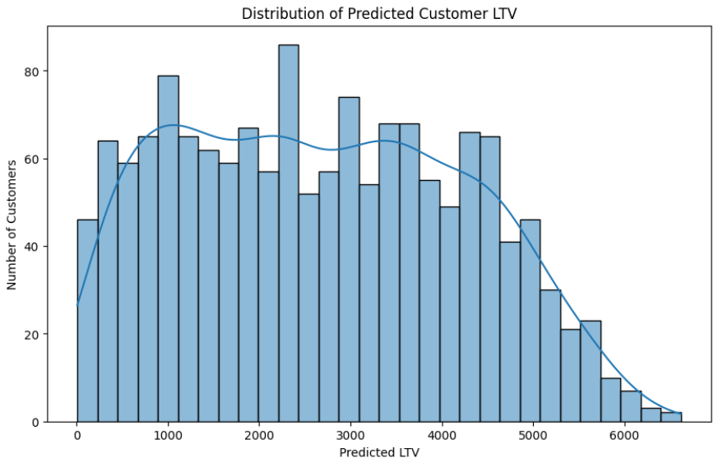
LTV Predictions
Predicted LTV for each customer
Exported as customer_LTV_predictions.csv
Visual: Histogram of predicted LTV values

Slide 8
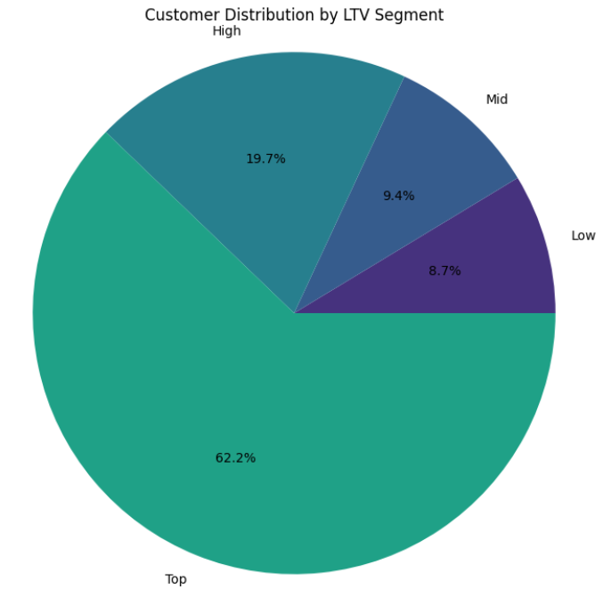
Customer Segmentation
Customers segmented into:
Top (top 10%)
High (10–30%)
Mid (30–70%)
Low (bottom 30%)

Slide 9
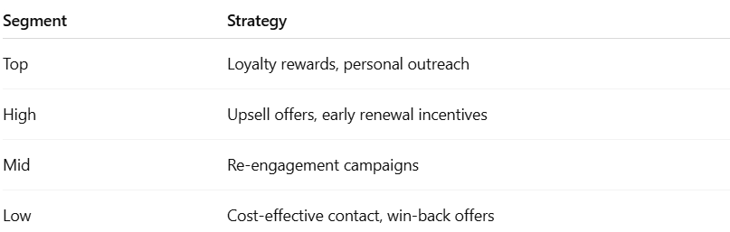
Strategic Recommendations

Slide 10
Next Steps
Enhance features (e.g., time between purchases, last order amount)
Test log-transformed LTV for improved model fit
Build dashboard for real-time LTV scoring
Schedule model retraining quarterly

Slide 11
Thank You Contact info : katariya.harsh2468@gmail.com GitHub info : Comhek0369

